Slide 2
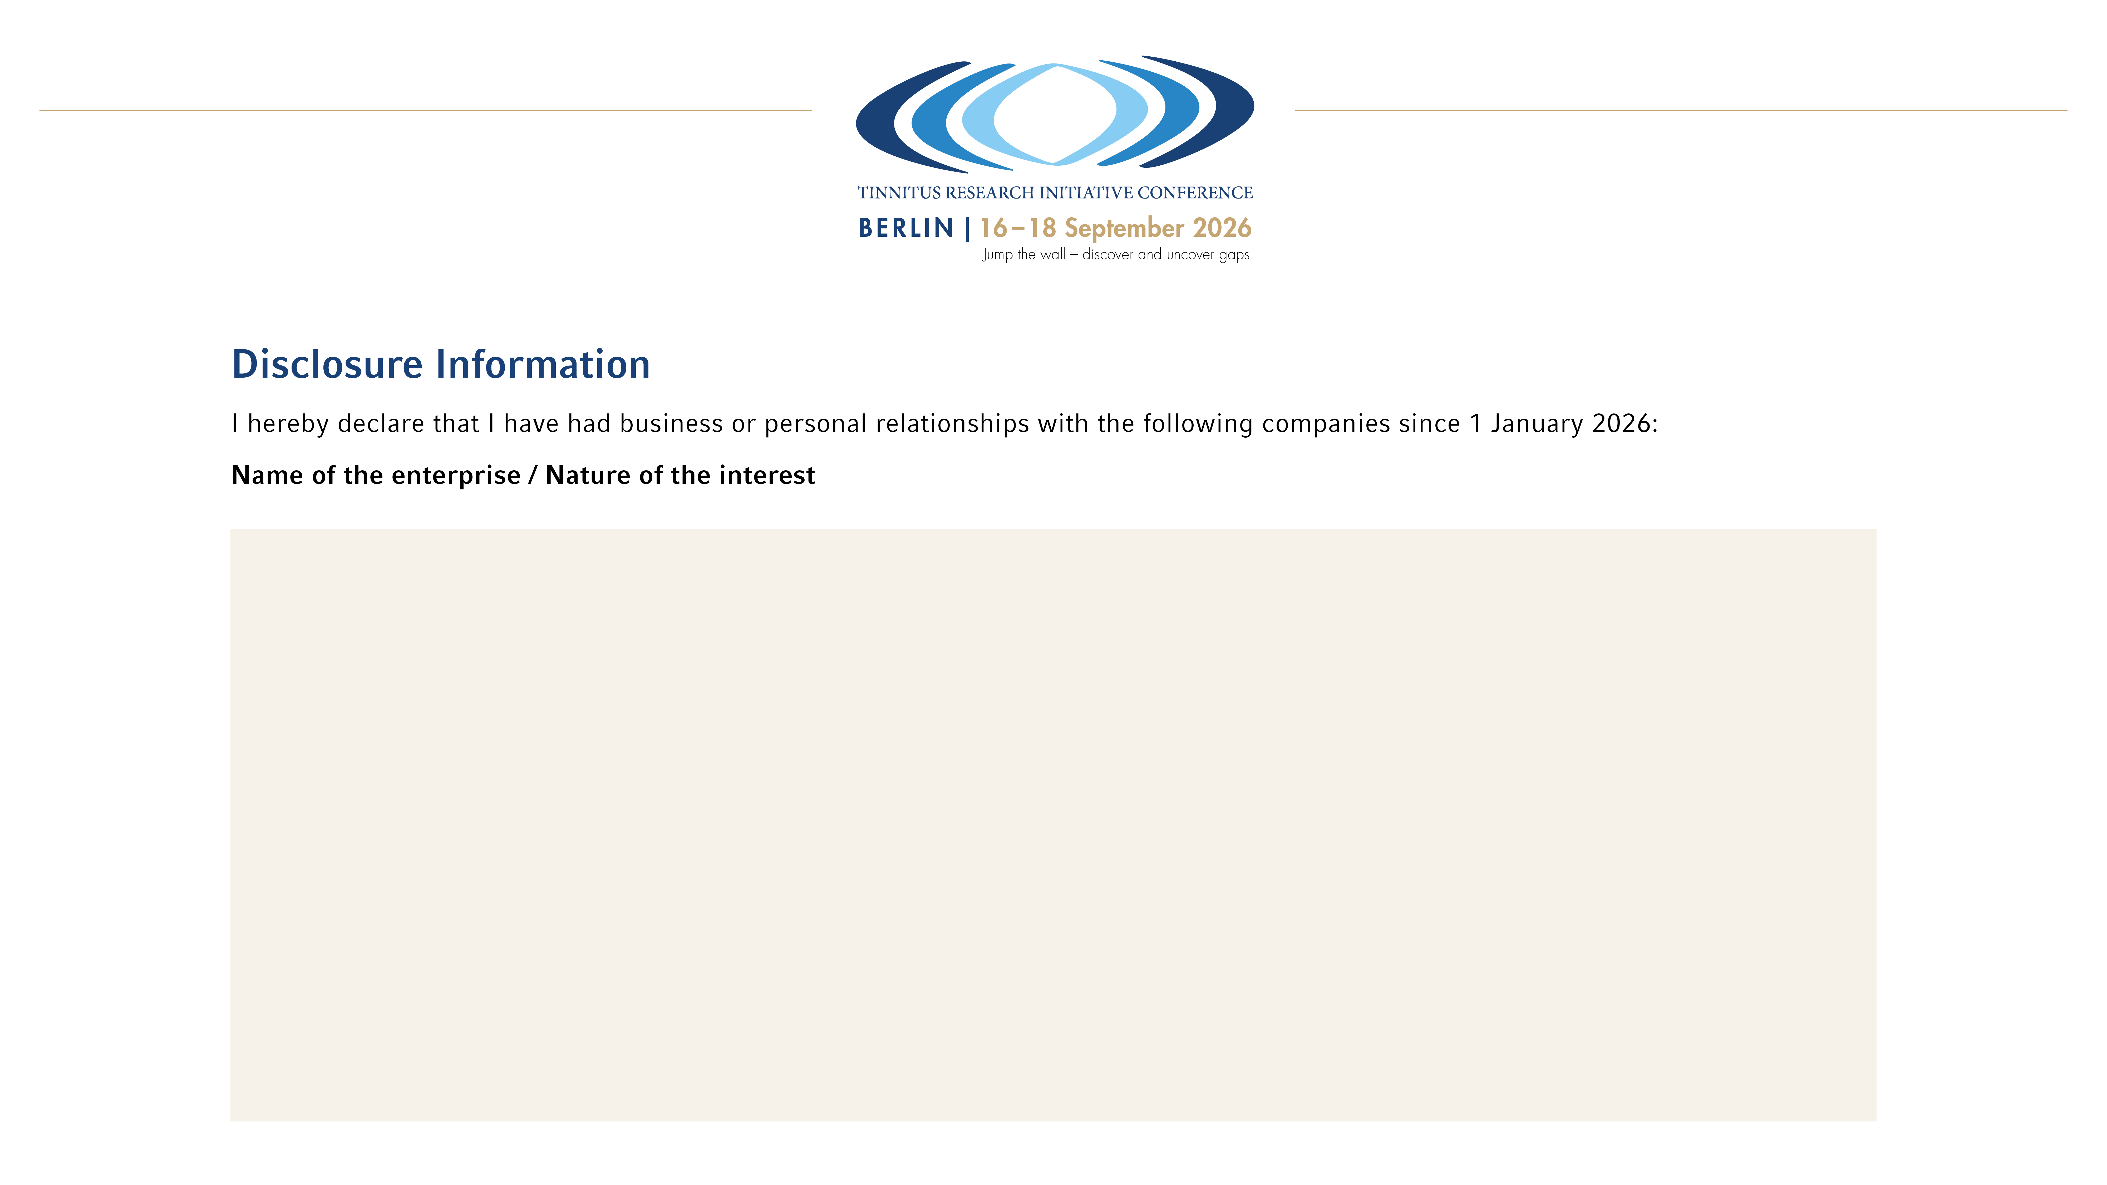
Enterprise | Interest
...

